Slide 1
Mini Project 1
Medical Insurance Price Prediction
Submitted By-
Anjandeep Kaur

Slide 2
Problem Statement
Insurance forecast by using regression algorithms health insurance is a type of insurance that covers medical expenses that arise due to an illness. these expenses could be related to hospitalization costs, cost of medicines or doctor consultation fees. the main purpose of medical insurance is to receive the best medical care without any strain on your finances. health insurance plans offer protection against high medical costs.
Objective: Develop a machine Learning model to predict charges.

Slide 3
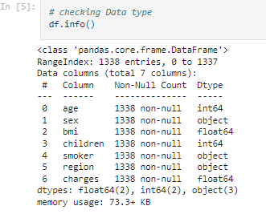
Dataset Information
We Have 7 feature in this Dataset.
We have dataset including Object, Integer And Float dataset.
We Have Total 1338 Rows.
We Do Not Have Any Null Values.

Slide 4
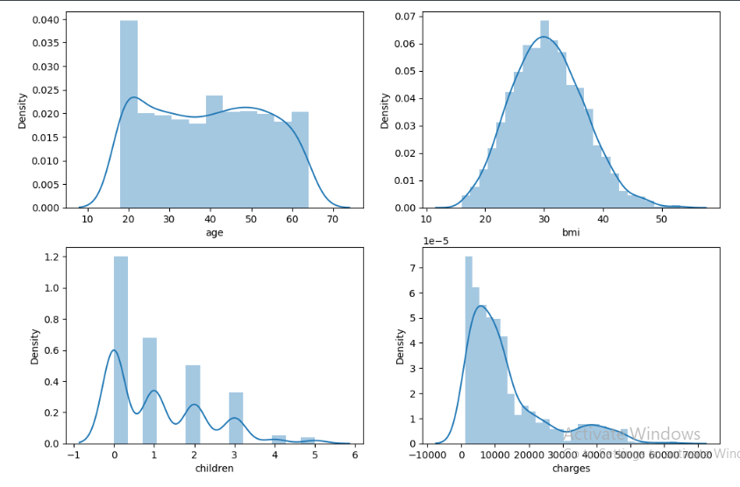
Data Visualization
Distribution Of Continuous Variables :
Children column shows skewness in the data

Slide 5
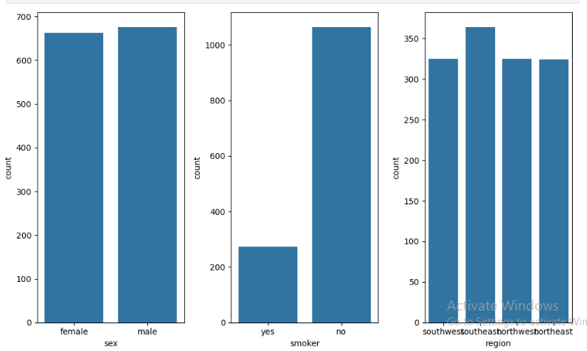
Distribution Of Categorical Variables:

Slide 6
Data Preprocessing
Perform Feature Encoding On Categorical Variables Using Label Encoding.
Scale Charges Using Max Min Scaler.
Handling Outliers : Plotting Boxplot BMI And Smoker Shows Outliers.
Use IQR (Intel Quantile Range) Method To Remove The Outliers
Use K-best Algorithm to select best features : age and smoker

Slide 7
Model Selection
Algorithms Tested :
Linear Regression
Random Forest
Decision Tree
Support Vector Regression
Cross Validation : Performed 5-fold cross validation to prevent overfitting
Hyper parameter Tuning : Applied Grid Search CV to the best algorithm

Slide 8
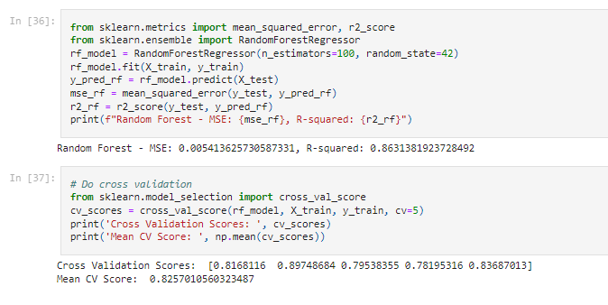
Model Evaluation and Metrics
Evaluation Metrics
Mean Squared Error
R squared Score
Best Performing Model
Random Forest with accuracy of 86%.

Slide 9
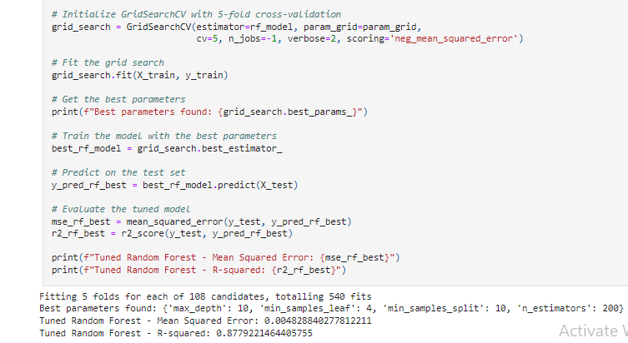
Hyper Parameter Tuning
Using Grid Search CV We Applied Hyper parameter Tuning And Improved The Accuracy To 87%.

Slide 10
Conclusion And Future Scope
Conclusion
Using The Medical Insurance Dataset In-depth Data Analysis Conducted.
Multiple Regression Models Were Trained And Random Forest Perform The Best.
Significant Features: Age And Smoker.
Future Scope
Implement more advanced models like Neural Networks
Testing with additional datasets or more features.

